Slide 1
Week 4
Climate Change

Slide 2
Session Outline
What is climate change?
What causes climate change?
How does climate change impact business?
Summary
Vocabulary Review
Assignments

Slide 3
Learning Objectives
By the end of this session, you will be able to:
Define climate change
Understand what causes climate change
Describe the impact of climate change on business

Slide 4
What is Climate Change?
Climate change: a long-term change in the Earth’s climate, or of a region on Earth (NASA, 2008)
Global warming: the increase in Earth’s average surface temperature due to rising levels of greenhouse gases (GHG) (NASA, 2008).
AKA Anthropogenic Global Warming
Within scientific journals, global warming refers to surface temperature increases while climate change includes global warming and everything else that increases GHG levels affect (NASA, 2008).

Slide 5
What Causes Climate Change?
Anthropogenic
Natural
Chemical Fertilizers
Deforestation
Increase Vehicle Use
Industries
GHG Emissions
Sun/Solar Cycle
Ocean Currents
Forest Fire
Volcanic Eruptions
Meteorites
Methane (animals)
Notes:
Image Source: http://image.slidesharecdn.com/newclimatechange-141029102246-conversion-gate01/95/climate-change-11-638.jpg?cb=1414578240

Slide 6
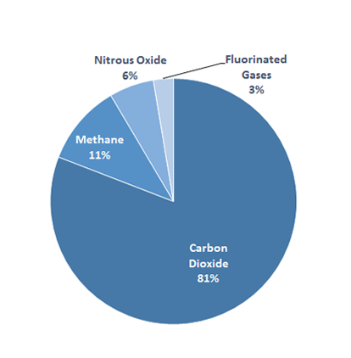
GHG
Carbon dioxide (CO₂)
Methane (CH₄)
Nitrous oxide (N₂O) :
Fluorinated gases :
Hydrofluorocarbons
Perfluorocarbons
Sulfur hexafluoride
Nitrogen trifluoride
Water Vapor*
[EPA. [Image]. Retrieved from: https://www3.epa.gov/climatechange/ghgemissions/gases.html]
Notes:
Image Source:

Slide 7
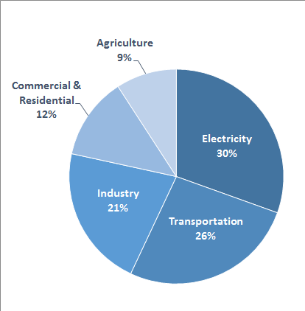
GHG Sources*
Electricity production (30% of 2014 greenhouse gas emissions)
Transportation (26% of 2014 greenhouse gas emissions)
Industry (21% of 2014 greenhouse gas emissions)
Commercial and Residential (12% of 2014 greenhouse gas emissions)
Agriculture (9% of 2014 greenhouse gas emissions)
Land Use and Forestry (offset of 11% of 2014 greenhouse gas emissions)
[EPA. [Image]. Retrieved from: https://www3.epa.gov/climatechange/ghgemissions/sources.html]
*GHG Emission in the US (EPA, 2014)
Notes:
Image Source:

Slide 8
What are the impacts?
Global Temperature Rise & Warming Oceans
Rise in Sea Level
Bio-diversity loss
Loss of land
Shrinking Ice Sheets
Declining Arctic Sea Ice
Glacial Retreat
Decreased Snow Cover
Ocean Acidification

Slide 9
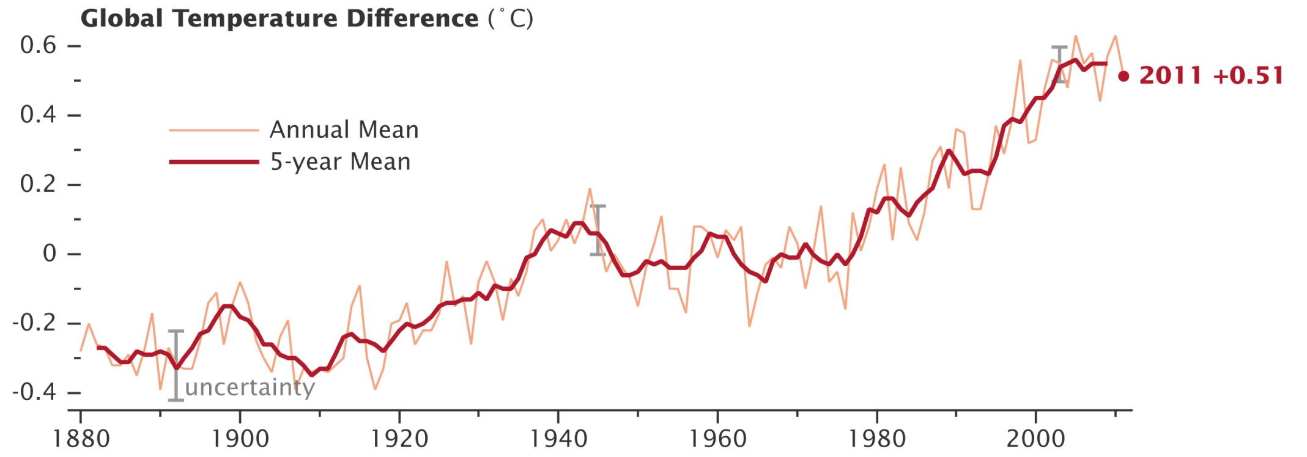
Global Temperature Rise
-Global temperature rise
-Differences calculated in Celsius
[NASA. [Image]. http://www.nasa.gov/images/content/616910main_gisstemp_2011_graph_lrg%5B1%5D.jpg]
Notes:
Image Source:

Slide 10
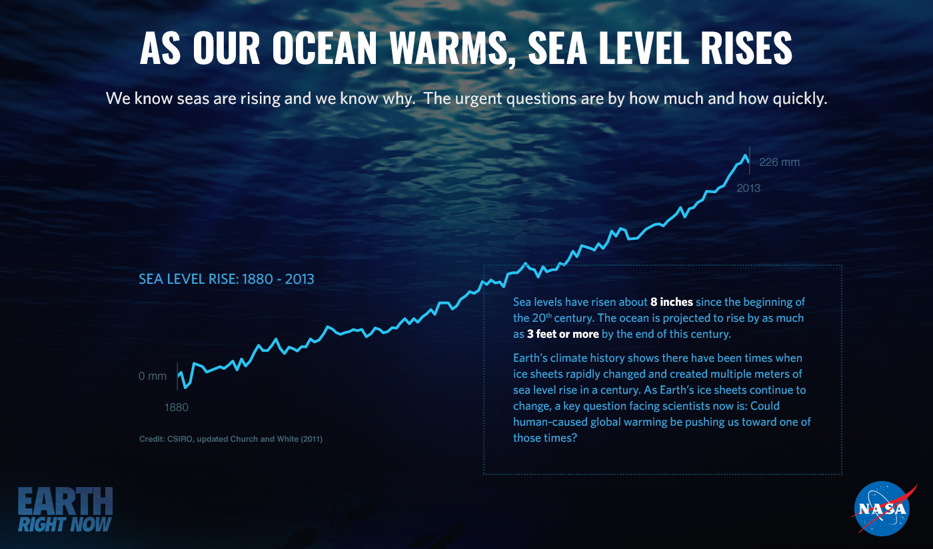
Rise in Sea Level
[NASA. [Image]. Retrieved from: http://www.nasa.gov/sites/default/files/thumbnails/image/slr.1.png]
Notes:
Image Source:

Slide 11
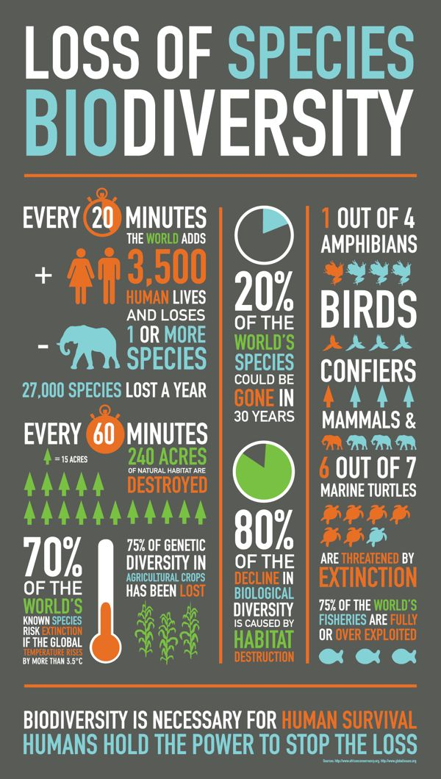
Biodiversity loss
Biodiversity loss: a reduction in the number of species in an environment and the number of individuals in each species.
[Pinimg. [Image]. Retrieved from: https://s-media-cache-ak0.pinimg.com/736x/8f/c1/b7/8fc1b7d5d97a32925afe0ad075cd9190.jpg]
Notes:
Image Source:

Slide 12
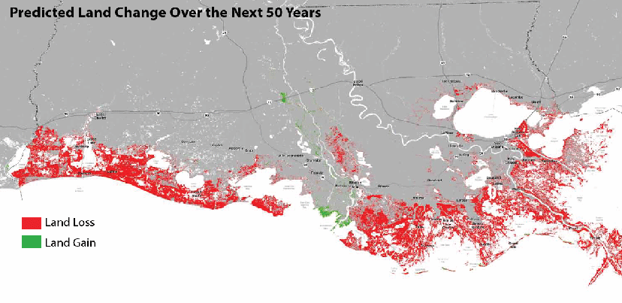
Loss of land
-Loss of land due to rising sea levels
-Ex: Mississippi River Delta in the US
[Mississippi River Delta. [Image]. Retrieved from: http://www.mississippiriverdelta.org/files/2012/06/Louisiana-land-loss-land-gain.gif]
Notes:
Image Source:

Slide 13
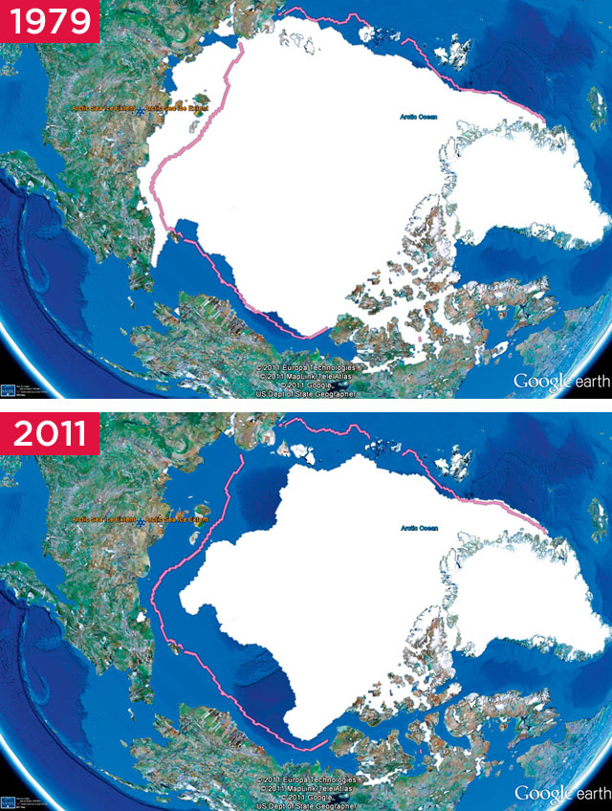
Shrinking Ice Sheets
-Ice Sheet: thick sheet of ice covering an extensive area for a long period of time or a glacier covering a large fraction of a continent
-Ex: the Arctic
[Huffington Post. [Image]. Retrieved from: http://images.huffingtonpost.com/2014-05-14-ArcticShrinkingIceEarthDrReeseHalter]

Slide 14
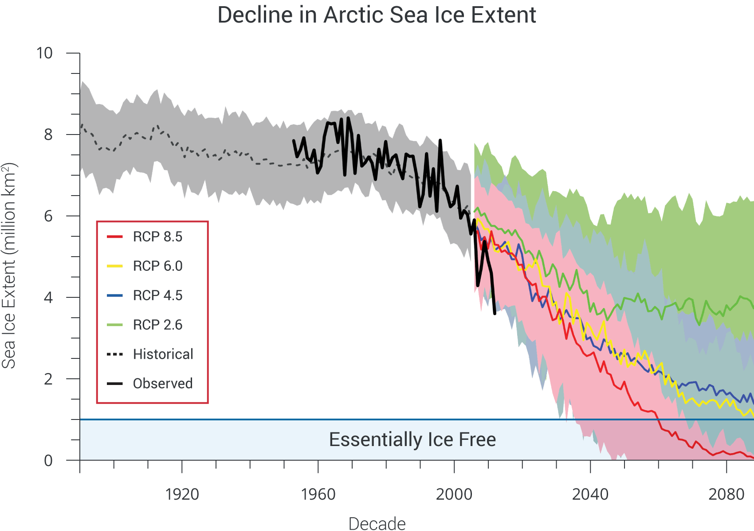
Declining Arctic Sea Ice
-Reduction in Arctic Sea Ice
-RPC: Representative Concentration Pathways (scenarios)
[Global Change. [Image]. Retrieved from: http://nca2014.globalchange.gov/sites/report/files/images/web-large/CS_sea-ice-projections_V6_0.png]
Notes:
Image Source:

Slide 15
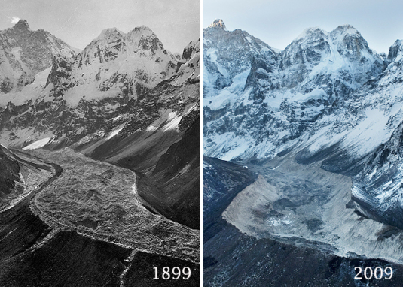
Glacial Retreat
-Glacial retreat affects the availability of fresh water for irrigation and domestic use, mountain recreation, and animals and plants that depend on glacier-melt
-Ex: Himalayas
[Water Planning Group. [Image]. Retrieved from: https://waterplanninggroup.com/2014/05/21/glacial-water-supply-and-climate-change/]
Notes:
Image Source:

Slide 16
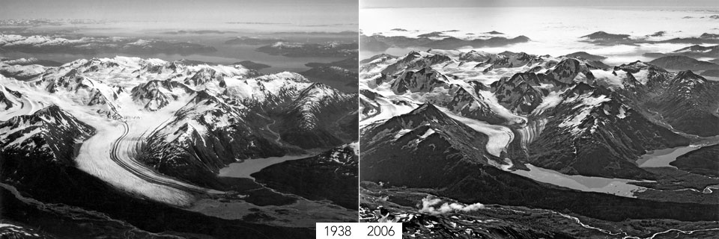
Decreased Snow Cover
-Ex: Alaska
[Esra Magazine. [Image]. Retrieved from: http://esra-magazine.com/useruploads/images/fever-4_(400x292).jpg]
Notes:
Image Source:

Slide 17
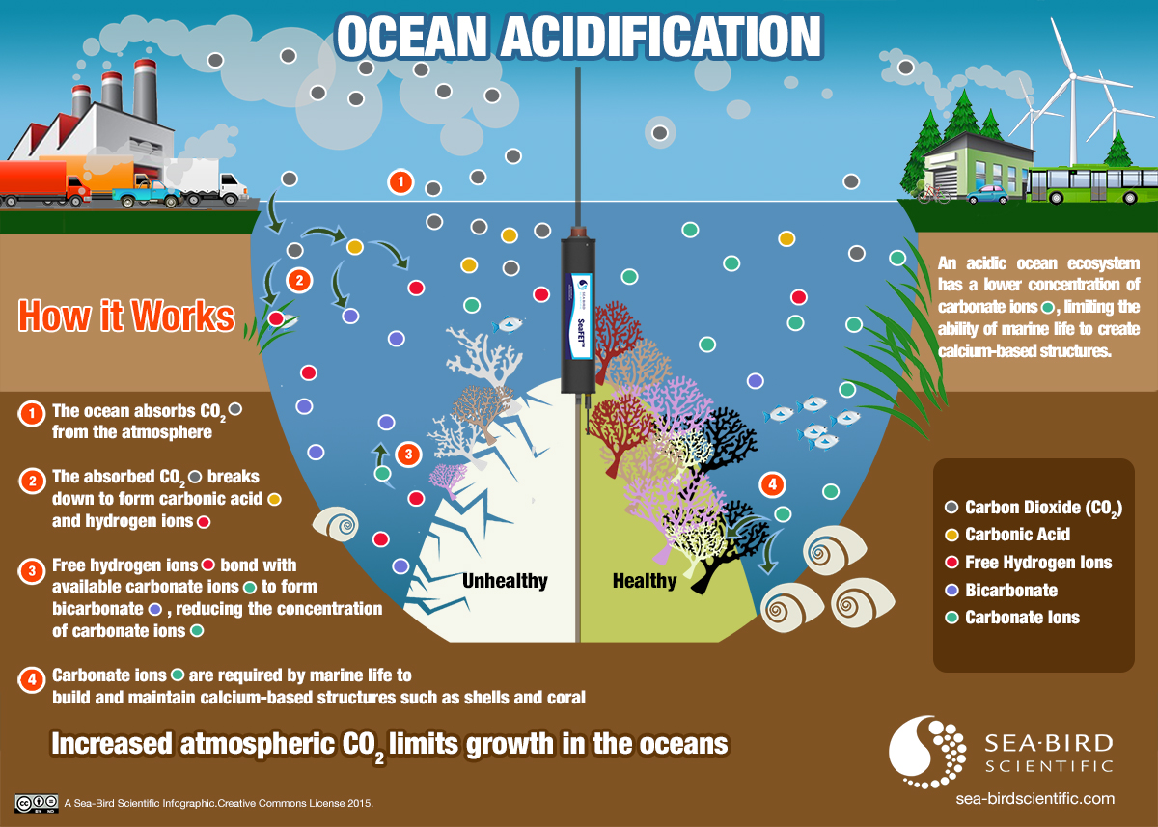
Ocean Acidification
[Sea-Bird Scientific. [Image]. Retrieved from: https://sea-birdscientific.com/pH/BlogPostAssets/images/oa_sbs_infographic.jpg]
Notes:
Image Source:

Slide 18
How is it measured?
Scientific Recordings:
Temperature: When measuring climate change this is a primary and can be measured or reconstructed for the Earth’s surface, and sea surface temperature (SST).
Precipitation (rainfall, snowfall, etc.): offers another indicator of relative climate variation and may include humidity or water balance, and water quality.
Biomass and vegetation patterns may be discerned in a variety of ways and provide evidence of how ecosystems change to adapt to climate change.
Sea Level measurements reflect changes in shoreline and usually relate to the degree of ice coverage in high latitudes and elevations.
Solar Activity can influence climate, primarily through changes in the intensity of solar radiation.
Volcanic Eruptions, like solar radiation, can alter climate due to the aerosols that are emitted into the atmosphere and alter climate patterns.
Chemical composition of air or water can be measured by tracking levels of greenhouse gases such as carbon dioxide and methane, and measuring ratios of oxygen isotopes. Research indicates a strong correlation between the percent of carbon dioxide in the atmosphere and the Earth’s mean temperature.

Slide 19
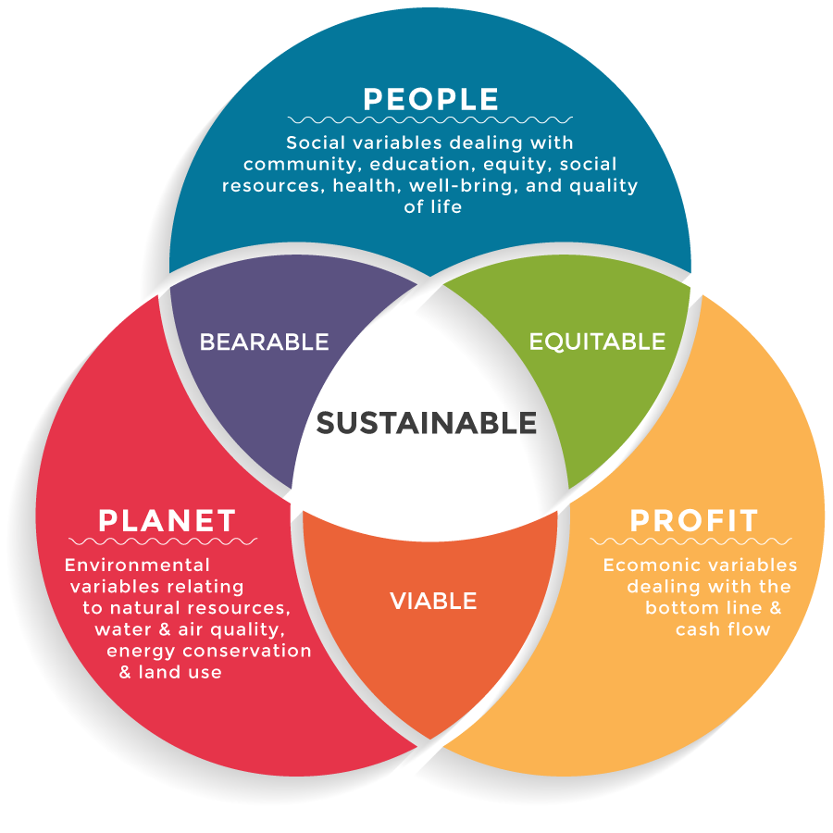
Relates to business
Climate Change effects all aspects of sustainability (Triple Bottom Line)
Environment
Economic
Social
[CSR Ambassadors. [Image]. Retrieved from: http://www.csrambassadors.com/wp-content/uploads/2016/03/triple-bottom-line-1.png]
Notes:
Image Source:

Slide 20

Legal Aspects
United Nations Framework Convention on Climate Change (UNFCCC)
The UNFCCC is a “Rio Convention”, one of three adopted at the “Rio Earth Summit” in 1992. Its sister Rio Conventions are the UN Convention on Biological Diversity and the Convention to Combat Desertification.
[UNFCCC. [Image]. Retrieved from: http://unfccc.int/files/inc/graphics/image/png/2011_logo.png]
Notes:
http://unfccc.int/essential_background/convention/items/6036.php

Slide 21
Legal Aspects Cont.
Kyoto Protocol (KP) is what “operationalizes” the Convention. It commits industrialized countries to stabilize GHG emissions based on the principles of the Convention.
The Convention itself only encourages countries to do so.
KP sets binding emission reduction targets for 37 industrialized countries and the European community in the first commitment period (2008-2012).
Doha Amendment to the Kyoto Protocol was adopted launching a second commitment period, starting on January 2013 until 2020
Notes:
http://unfccc.int/essential_background/kyoto_protocol/items/6034.php

Slide 22


WTO & UNEP
Price and market mechanisms to internalize environmental costs of GHG emissions
i.e. “Carbon Tax”
Financial mechanisms to promote the development and deployment of climate-friendly goods and technologies
i.e. In Germany, a public bank provides private companies low-interest loans for specific renewable energy projects.
Technical requirements to promote the use of climate-friendly goods and technologies
i.e. Australia the Minimum Energy Performance Standards (MEPS) for appliances are mandatory regulations; while in the US, ENERGY STAR is a voluntary labelling endorsement program
[Daikin. [Image]. Retrieved from: http://commercial.daikin.com.au/sites/default/files/u4209/MEPS%20logo.JPG]
[Energy Star. [Image]. Retrieved from: https://p5.zdassets.com/hc/settings_assets/821026/200163838/tB12oDafVQEIGDe8i2ApXw-Energy_Star.jpg]

Slide 23
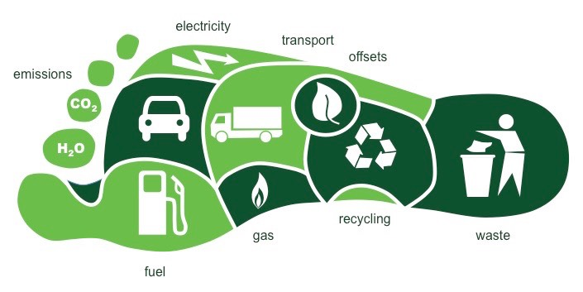
Possible Solution
Reduce Carbon Footprint
Individually + Collectively
Definition: The total amount of greenhouse gases produced to directly and indirectly support human activities, usually expressed in equivalent tons of carbon dioxide (CO₂).
[Bioninja. [Image]. Retrieved from: http://ib.bioninja.com.au/_Media/carbon-footprint_med.jpeg]

Slide 24
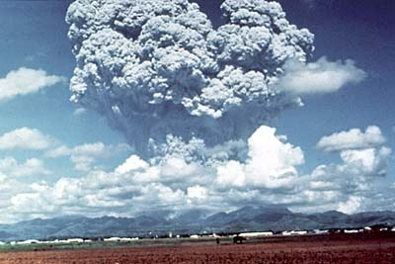
Possible Solution Cont.
Inject Sulfur Dioxide (SO₂) in the Stratosphere like Mount Pinatubo
This led to a decrease in northern hemisphere average temperatures of 0.5–0.6 °C (0.9–1.1 °F) and a global fall of about 0.4 °C (0.7 °F) for a few years.
[USGS. [Image]. Retrieved from: http://pubs.usgs.gov/fs/1997/fs113-97/resources/AshCloud.jpg]

Slide 25
Summary
Learning Objectives
What is Climate Change
What causes Climate Change
Impacts and business application of Climate Change

Slide 26
Vocabulary Review
Climate Change: a long-term change in the Earth’s climate, or of a region on Earth
Global Warming: the increase in Earth’s average surface temperature due to rising levels of greenhouse gases (GHG)
UNFCCC: United Nations Framework Convention on Climate Change
Kyoto Protocol (KP): sets binding emission reduction targets for 37 industrialized countries and the European community in the first commitment period (2008-2012).
WTO: World Trade Organization
UNEP: United Nations Environment Programmee
GHG: is a gas in an atmosphere that absorbs and emits radiation within the thermal infrared range.
Global Temperature Rise: the average global temperature on Earth has increased by about 0.8° Celsius (1.4° Fahrenheit) since 1880
Rise in Sea Level: Two things that contribute to sea level rise 1) thermal expansion: because of the increase in ocean heat content (ocean water expands as it warms); and 2) the melting of major stores of land ice like ice sheets and glaciers.
Biodiversity loss: a reduction in the number of species in an environment and the number of individuals in each species.
Shrinking Ice Sheets: a permanent layer of ice covering an extensive tract of land, especially a polar region.
Declining Arctic Sea Ice: sea ice loss observed in recent decades in the Arctic Ocean.
Glacial Retreat: The retreat of glaciers since 1850 affects the availability of fresh water for irrigation and domestic use, mountain recreation, animals and plants that depend on ...
Ocean Acidification: is the ongoing decrease in the pH of the Earth's oceans, caused by the uptake of carbon dioxide (CO₂) from the atmosphere.

Slide 27
Required Materials
Videos
Climate Change, Michael Sieng. Available on the course website.
My Country Will Be Underwater Soon – Unless We Work Together, Anote Tong, TED, Oct 2015.
Readings
Agriculture and Horticulture Poland, ClimateChangePost.
Agriculture and Horticulture Czech Republic, ClimateChangePost.
Business Emission Reduction Tips, ClimateCare blog.

Slide 28
Supplemental References
Videos
The 11th Hour, Warner Brothers, 2007.
New Thinking on the Climate Crisis, Al Gore, TED, 2008.
Readings
Global Climate Projections, Intergovernmental Panel on Climate Change, 2007.
Websites
Carbon Calculator, Carbon Footprint Ltd.
What’s My Carbon Footprint?, Nature Conservancy
Footprint Calculator, Global Footprint Network

Slide 29
Assignment
In your own words, summarize some ways a business can reduce their carbon footprint. Your response should be about 200 words. Please post your answer to the discussion board forum for Week 4.

Slide 30
References
Carbon Footprint Ltd. (2016). Carbon Footprint Calculator. Carbon Footprint . Retrieved August 8, 2016, from http://www.carbonfootprint.com/calculator.aspx
Charnovitz, S. (2010). Trade and Climate Change: A Report by the United Nations Environment Programme and the World Trade Organization by UNEP and the WTO Geneva: WTO, 2009. World Trade Review, 9(01), 273-281. doi:10.1017/s1474745609990206
www.aljazeera.com/news/2016/08/russian-anthrax-outbreak-blamed-climate-change-160805084805263.html
Global Footprint Network (2016). Footprint Calculator. Global Footprint Network. Retrieved August 8, 2016, from http://www.footprintnetwork.org/en/index.php/GFN/page/calculators/
Gore, A. (2008, March). Al Gore: New thinking on the climate crisis [Video file]. Retrieved from http://www.ted.com/talks/al_gore_s_new_thinking_on_the_climate_crisis
Guggenheim, D. (Director), & David, L., Bender, L., & Burns, S. Z. (Producers). (2006). An inconvenient truth [Video file]. Retrieved August 08, 2016, from https://tubitv.com/video/307853/an_inconvenient_truth
IPCC - Intergovernmental Panel on Climate Change. (2007). Retrieved August 08, 2016, from http://www.ipcc.ch/publications_and_data/ar4/wg1/en/ch10.html
Kyoto Protocol. (2016). Retrieved August 8, 2016, from http://unfccc.int/kyoto_protocol/items/2830.php National Aeronautics and Space Administration (NASA). (2016). Retrieved August 09, 2016, from http://www.nasa.gov/
Oceanographic Sensors and Systems. (2016). Retrieved August 09, 2016, from https://sea-birdscientific.com/
Petersen, L. C., & Conners, N. (Directors), Petersen, L. C., DiCaprio, L., Castleberry, C., & Gerber, B. (Producers), & Petersen, L. C., Conners, N., DiCaprio, L., & DiCaprio, L. (Writers). (2007). The 11th hour [Video file]. Retrieved August 08, 2016, from http://documentary-movie.com/the-11th-hour/
The Nature Conservancy (2016). What’s My Carbon Footprint? The Nature Conservancy. Retrieved August 8, 2016, from http://www.nature.org/greenliving/carboncalculator/
Tong, A. (2015, October). Anote Tong: My country will be underwater soon – unless we work together [Video file]. Retrieved from http://www.ted.com/talks/anote_tong_my_country_will_be_underwater_soon_unless_we_work_together
United Nations Framework Convention on Climate Change. (2016). Retrieved August 8, 2016, from http://unfccc.int/2860.php
US Environmental Protection Agency (EPA). (2016). Retrieved August 09, 2016, from https://www.epa.gov/

